Slide 1
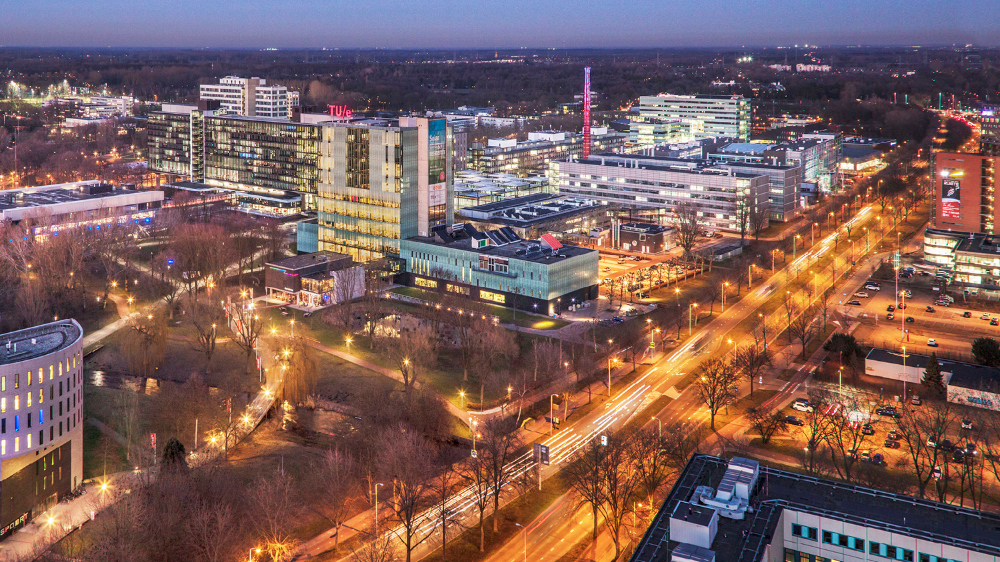
EfficientNet: Rethinking Model Scaling for Convolutional Neural Networks
Yunus Emre
ME-AIESW

Slide 2
Contents:
Introduction
Related Work
Compound Scaling
Architecture
Results & Limitations
Conclusion
Notes:
I will briefly talk about the top So the contents are we will cover are short introduction to the problem statement. Some related work covered in the paper. We’ll talk about the compound scaling method, its architecture, the results obtained. And finally some concluding remarks.

Slide 3
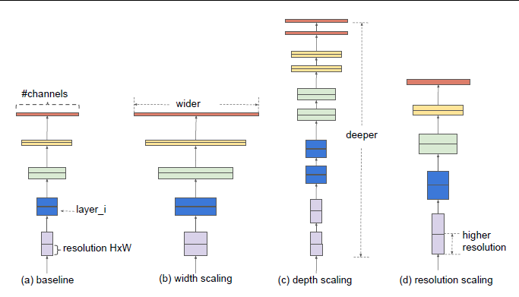
Introduction
Scaling ConvNets
Usually Depth or Width
More popular: image resolution
Notes:
I will introduce a little bit about the problem statement and the reasoning why we want to scale up networks. In general scaling up ConvNets is used to improve accuracies of the network as it has shown work, for example with ResNet where ResNet can be scaled up by using more layers to achieve higher ImageNet Accuracies.
(84.3% ImageNet
top-1 accuracy) Scaling however is not something that is understood that well, and it can and is used in different ways. Usually when people want to increase performance of a model they scale the depth of the network by adding more layers. Or changing increasing the width of the channels after a certain number of layers. One way that is a bit less often used, but getting more popular especially in today’s age is scaling up models using higher image resolutions.
So you only have three dimensions to scale (see images). But scaling them is done arbitrary and is just a lot of hand tuning and comes down to just estimated guessing if not guessing. This often requires a lot of manual time, and results in sub-optimal accurcies and efficiency.

Slide 4
Introduction
“The goal is to study and rethink the process of scaling up
Convnets.
In particular, we investigate the central question: is there a principled method to scale up ConvNets that can achieve better accuracy and efficiency”

Slide 5
Related Work
ConvNet Accuracy
ImageNet 2014: 6.8M parameters - 74.8% top-1 accuracy
ImageNet 2018: 557M parameters - 84.3% top-1 accuracy
ConvNet Efficiency:
Small and Fast
Model Scaling:
Unclear how to scale both dimenisions
Notes:
Since 2012 when AlexNet won the ImageNet competition, convnets have become more accuracte by going bigger. So has the winner of ImageNet in 2014 6.8M paramters with a 74.8% top-1 accuracy, and in 2018 Gpipe achieved a ImageNet top-1 validation accuracy to 84.3% using 557M almost 100x more parameters. While only slight increase in percentage. I.e. the models become way too bit, so we need to be more efficient
Parameters. Model compression is a common way to reduce the paramters trading of accuracy for efficiency. Think for example of the convnets on your phone, they need to be able to be light-weight and fast enough to work.
Model Scaling
As mentioned before there are a few ways to scale networks. Resnet can be scaled by either increasing or decreasing the amount of layers, while WideResNet and MobileNets, are scaled by their width/#channels.
But it is still unclear how to efficiently scale both dimensions.

Slide 6
Methodology - novelty of the approach
23.04.2021
Huang Shao-Kai
ME – AIES
Notes:
Thanks Yunus, this is Huang Shao-Kai and I will take care of the methodology part.
In this paper, there are two key points, Compound model scaling and EfficientNet architecture, which make EfficientNet so efficient
We will first talk about the part of compound scaling

Slide 7

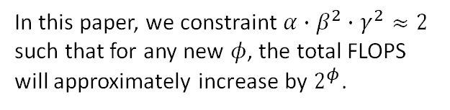
Compound Model Scaling
Formulating the scaling problem by increasing width, depth, and resolution coefficients in specific proportion.
In this paper, we constraint $α∙β^{2}∙γ^{2}≈2$ such that for any new $φ$, the total FLOPS will approximately increase by $2^{φ}$.
$depth:d= α^{φ}$
$width:w= β^{φ}$
$$resolution:r=γ^{φ}$$
$s.t. α∙β^{2}∙γ^{2}≈2$
$α≥1,β≥1,γ≥1$
But why applying this method ?
Notes:
Basically, there are several properties of a model we can change to design our own model.
They used to be the depth, width, and resolution. In this paper, we apply a formula alpha multiply beta square multiply gamma square approximately equals to two,
where alpha beta gamma respectively equals to depth width and resolution.
Use this formula to find out the restricted proportion between three different properties and apply another parameter phi to scale the model with the fixed proportion.
But why we have scale three different properties in the same time?

Slide 8
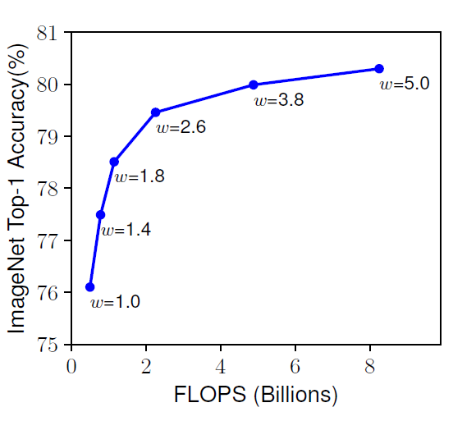
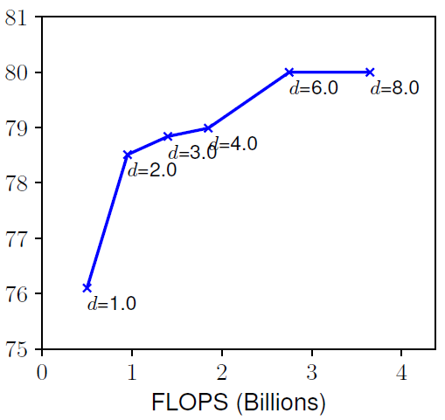
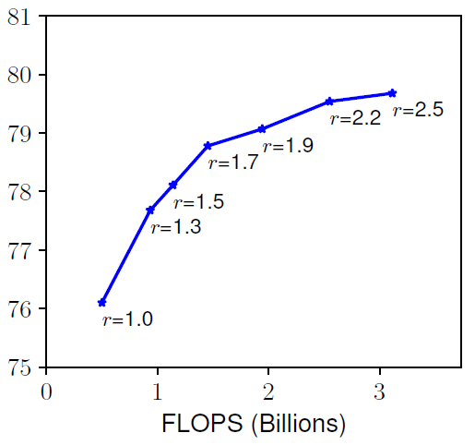
If we just increase each coefficient individually …
Width
Depth
Resolution
Notes:
If we look the width depth and resolution individually, it's easily saturated when model becomes only wider, deeper, or having higher resolution.
So after the certain point, there's no obvious improvement anymore.
According to the experiment, the author find out applying compound scaling can successfully overcome the saturation and gain more accuracy by the formula in previous slide.

Slide 9
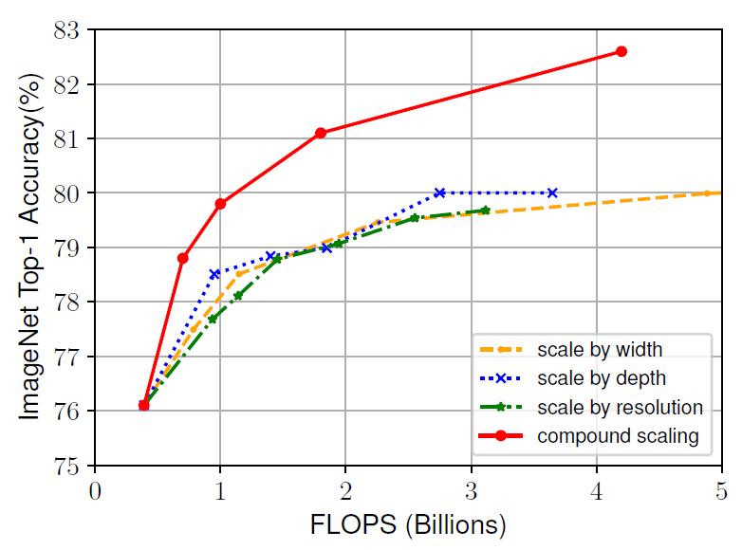
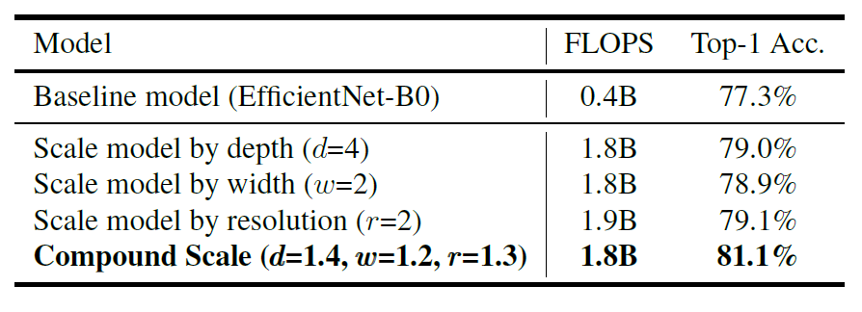
Apply compound scaling method and make comparison
Notes:
Just take a look at table and line graph. Based on almost same FLOPS, we can see the model scaled by compound scaling does act better than other single-property- scaled model.
Also, we can see the compound scaling brings almost 3% higher accuracy than other single-property- scaled methods with same 4 billions FLOPS.
Then, let's look at the architecture.

Slide 10
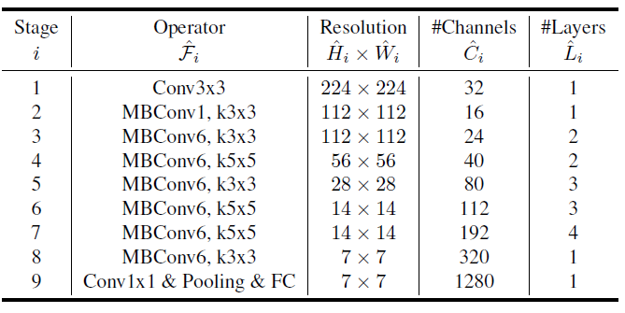

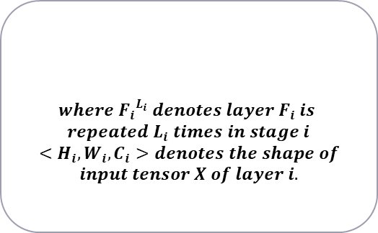
EfficientNet Architecture
Apply NAS to find the EfficientNet-B0 baseline network and scale the baseline model by compound scaling method.
$$where {F_{i}}^{L_{i}} denotes layer F_{i} is$$
$$repeated L_{i} times in stage i$$
$$<H_{i},W_{i},C_{i}>denotes the shape of$$
$$input tensor X of layer i.$$
Notes:
With the scaling method, we still need the basic unit architecture to be scaled.
In this paper, the author apply the NAS (network architecture searching) to find the EfficientNet-B0 baseline network.
After we have the baseline model, we can apply the compound scaling method by adjusting the resolution channels and layers all together

Slide 11
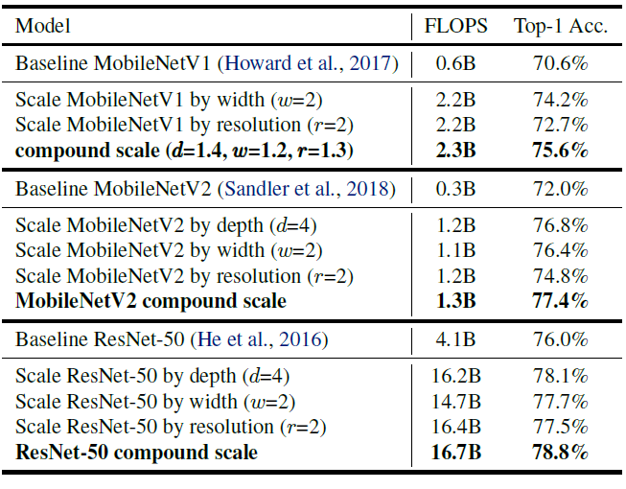
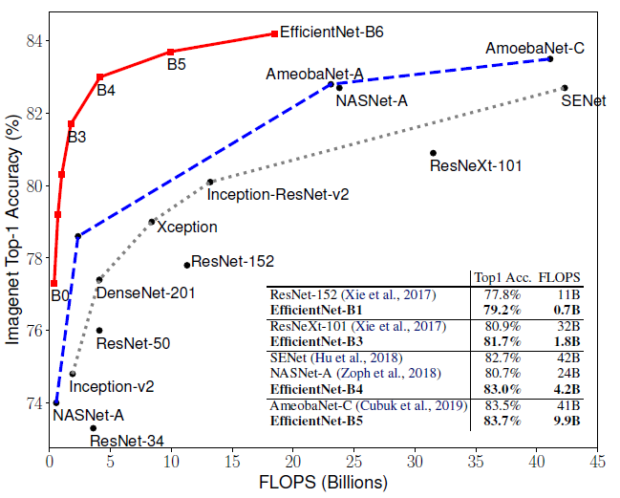
Compare with MobileNets and ResNet
Notes:
Let's compare the EfficientNet with MobileNets and ResNet.
Look at the table on the left side, we can see MobileNetV1 MobileNetV2 and ResNet-50 with and without compound scaling.
We easily find out that there's a better effect after applying compound scaling, that is to say higher accuracy.
How about we apply the compound scaling on our own EfficientNet-B0 baseline model?
We can the see the comparison result on the right image.
With the better architecture unit and compound scaling technique, the extended EfficientNet B0 to B6 has way better performance compared to the rest.

Slide 12
Result and Discussion
On Advantages and Limitations of Efficientnet
Lecturer: Yibo Shi
EE Department, CS Group
Notes:
Thanks Shao-kai, this is Yibo Shi and I will show some main results this paper want to show and also talk about the limitations we found.

Slide 13
Good performance described in the paper:
Flexibility of baseline selection
Convenient hyperparameter tuning
Better computational efficiency
Better performance
Better transfer learning performance
Notes:
I believe that in the previous introduction, you have already understood how efficientnet works.
In each part of the paper, the author shows us some of its advantages, and I will introduce mainly the 5 aspects above.

Slide 14

Convenient baseline selection and hyperparameter tuning
Develop the baseline network by leveraging a multi-objective neural architecture search optimizing accuracy and FLOPS just as [1].
Hyperparameter tuning:
$depth:d= α^{φ}$
$width:w= β^{φ}$
$$resolution:r=γ^{φ}$$
$s.t. α∙β^{2}∙γ^{2}≈2$
$α≥1,β≥1,γ≥1$
Step 1: Fix φ, find best α, β, and γ
Step 2: Fix α, β, and γ, find the best φ
[1] Tan, M., Chen, B., Pang, R., Vasudevan, V., Sandler, M., Howard, A., and Le, Q. V. MnasNet: Platform-aware neural architecture search for mobile. CVPR, 2019.
Notes:
Firstly, efficientnet does not need to re-develop the method of baseline searching.
The author used the method from his previous paper used for MnasNet, and aiming at optimizing the accuracy and computational efficiency, and directly generated the baselines of various architectures, which is the EfficientNet-B0 to B7.
According to the description in the article, hyperparameter tuning only takes two steps.
First, according to the relationship between a, b and c determined on the left, with phi fixed, find the best a, b and c.
Then fix a, b and c to find the best phi.
This method can reduce the workload of hyperparameter tuning.

Slide 15
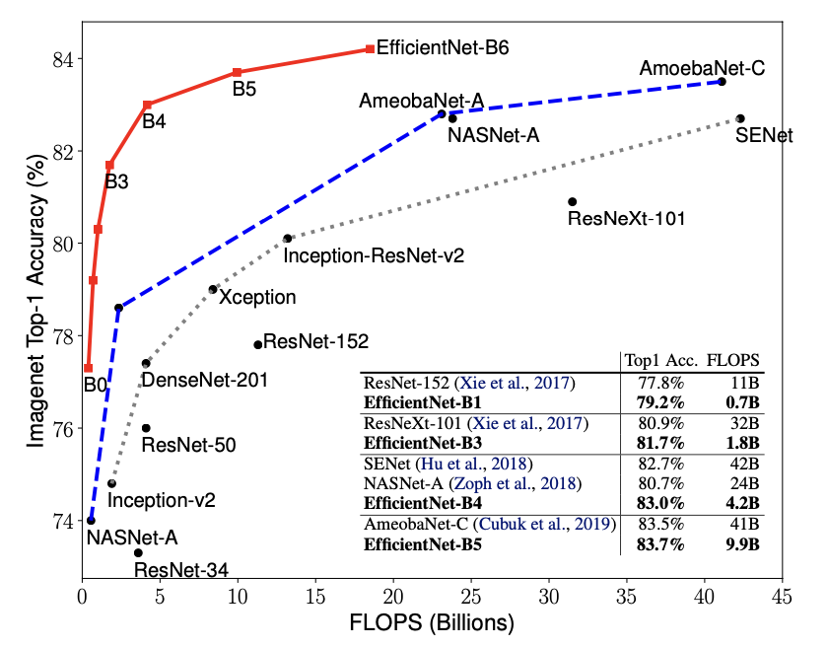
Better performance and higher computational efficiency
Among different nets
With different scaling method
Notes:
From the perspective of network performance, whether it is a comparison between different models or a comparison between different scale methods of the same model,
the accuracy and training efficiency of efficientnet are both competitive enough.

Slide 16
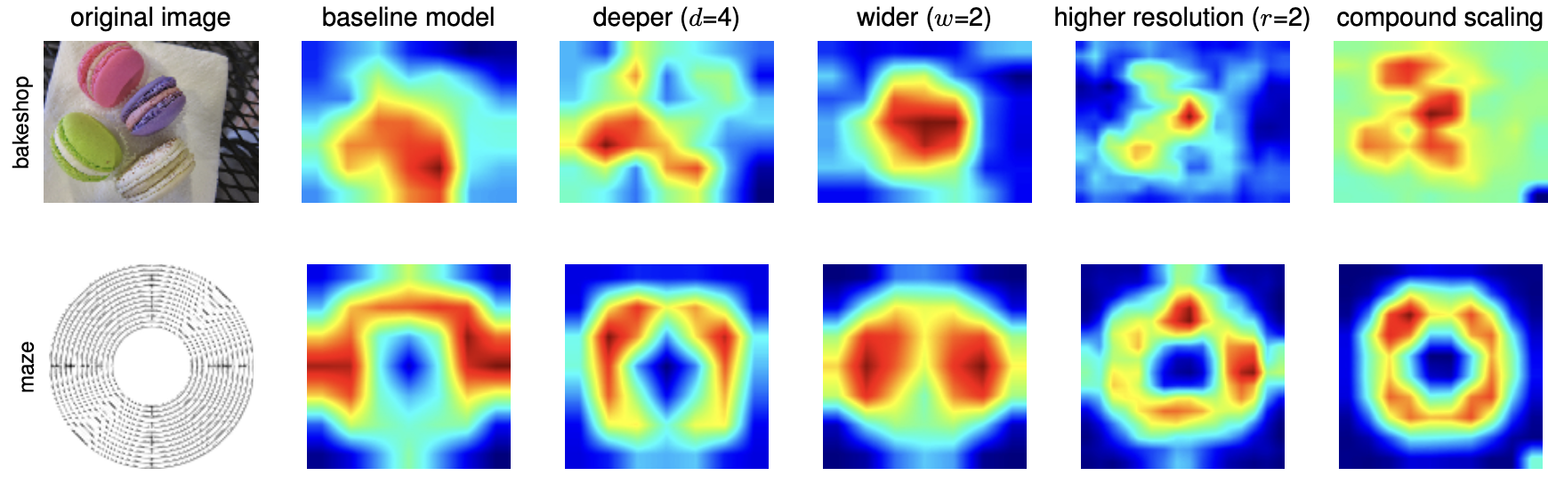
The compound scaling method allows the scaled model to focus on more relevant regions with more object details
Notes:
From the perspective of class activation map, compound scaling can also help the model learn more correct knowledge about the data and thus achieve better performance.

Slide 17
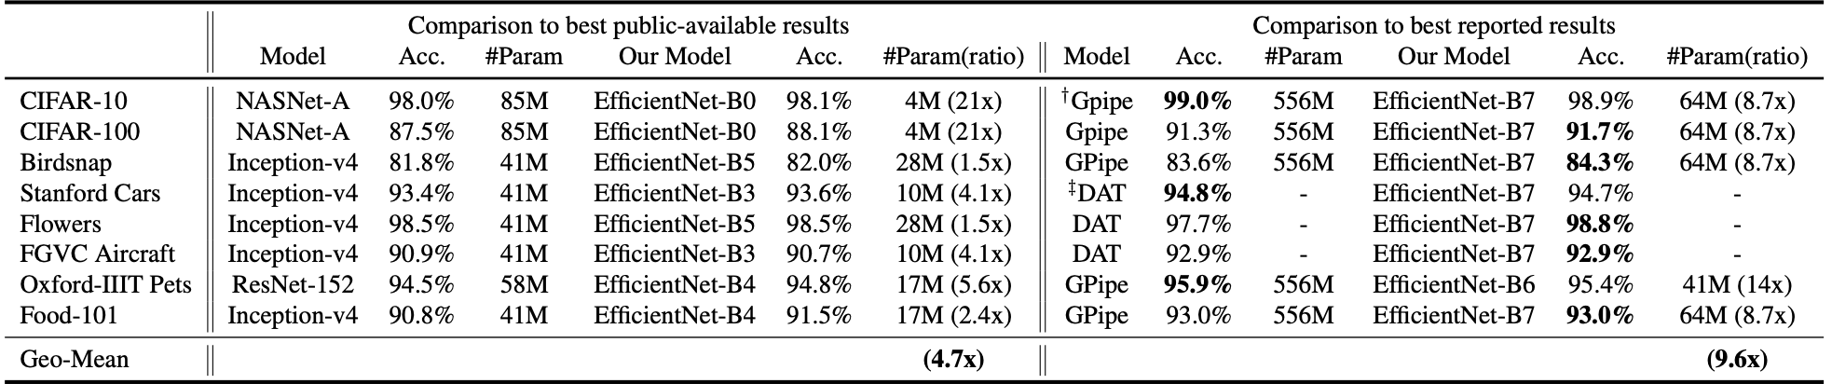
Better transfer learning performance
Notes:
We can also see the table of transfer learning performance.
As expected, efficientnet also maintains high accuracy and high computational efficiency in the transfer learning case.

Slide 18
Some limitations we found：
The combination relationship between hyperparameters cannot be optimized
The relationship between network architecture and hyperparamet-er combination is not clear
The object of comparison in the paper is relatively single
Notes:
However, we also saw some limitations that were not pointed out in the article.
First of all, only one parameter combination of compound scaling is given in the article. Although good results can be obtained by this combination, we cannot guarantee the optimality of this combination relationship, and this combination relationship cannot be optimized.
Secondly, we can see that the author chose the architecture he obtained through NAS in another paper of his, so this article is more like a by-product based on a specific architecture, and we cannot guarantee whether the proposed compound scaling method can also achieve good results when being applied to other architectures.
Finally, our teammates pointed out that in order to show the advantages of the network in the article, the author chose a relatively single comparison objects.
This is all of mine part.

Slide 19
Conclusion
23.04.2021
Huang Shao-Kai
ME – AIES
Notes:
Thanks Shao-kai, this is Yibo Shi and I will show some main results this paper want to show and also talk about the limitations we found.

Slide 20
Conclusion：
Offer the designer a followable scaling method to get lower FLOPS and higher accuracy model.
Overcome the accuracy saturation of tuning parameters separately.
Notes:
However, we also saw some limitations that were not pointed out in the article.
First of all, only one parameter combination of compound scaling is given in the article. Although good results can be obtained by this combination, we cannot guarantee the optimality of this combination relationship, and this combination relationship cannot be optimized.
Secondly, we can see that the author chose the architecture he obtained through NAS in another paper of his, so this article is more like a by-product based on a specific architecture, and we cannot guarantee whether the proposed compound scaling method can also achieve good results when being applied to other architectures.
Finally, our teammates pointed out that in order to show the advantages of the network in the article, the author chose a relatively single comparison objects.
This is all of mine part.

